Slide 1

Dimensionality and PCA
SHAI For AI

Slide 2

Curse of Dimensionality.
Many machine learning algorithms have thousands or million of features , this make the training very slow and very hard to find a solution and it is harder to do data visualization, this problem is referred to as curse of dimensionality.
Notes:
Dimensionality reduction simply refers to the process of reducing the number of attributes in a dataset while keeping as much of the variation in the original dataset as possible.

Slide 3
Curse of Dimensionality.
Is there a solution ?

Slide 4
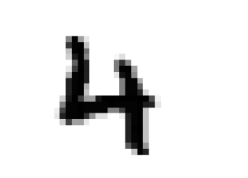
Curse of Dimensionality.
Is there a solution ?
YES !!
Try to reduce number of features
For example in our mnist project, you could get rid of some of the extra white pixels, or you could combine two similar(highly correlated) pixels in one pixel. You will not lose much information and you might filter out some of the noise

Slide 5
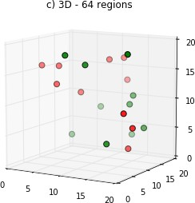
Curse of Dimensionality.
More dimension (features) means risk of being very sparse, and most training instances will be far from each other, which means that a new instance will likely be far away from any training instance, making predictions much less reliable than in lower dimensions the more dimensions the training set has, the greater the risk of overfitting it.

Slide 6
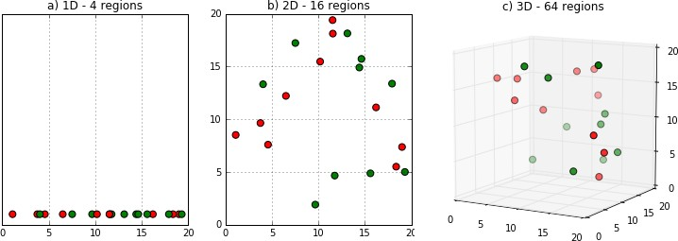
Dimensionality Reduction
Data preprocessing step.
Lose some variability and information.
But get a more efficient and digestible form of data, that is easier to process by different ML algorithms.
Used for making a representative visualization of the data.
Notes:
data preprocessing step meaning that we perform dimensionality reduction before training the model.
A lower number of dimensions in data means less training time and less computational resources and increases the overall performance of machine learning algorithms
avoids the problem of overfitting
removing noise from data by disregarding less important features
can be used to compress images - minimizing bytes of an image while keeping as much of the image quality as possible
<figure below>
In a high-dimensional dataset, most data points are likely to be far away from each other. Therefore, the algorithms cannot effectively and efficiently train on the high-dimensional data.

Slide 7
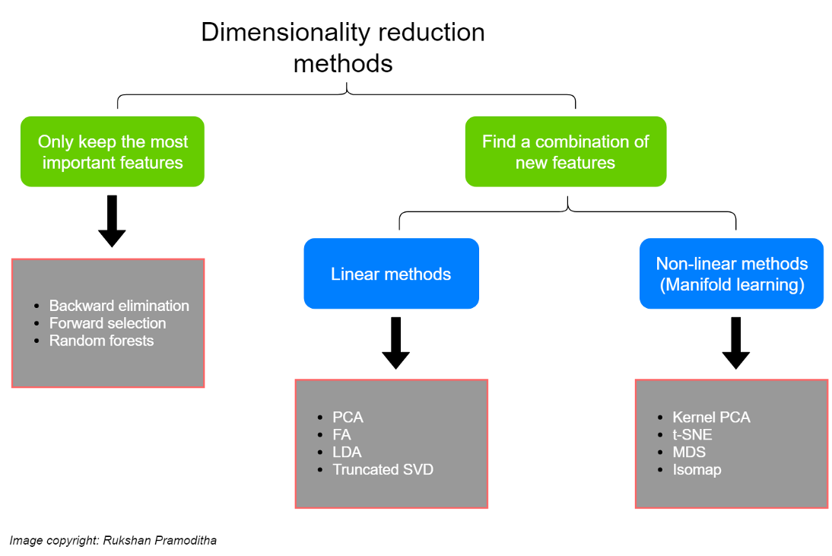
Dimensionality Reduction - Types
Notes:
One type of method only keeps the most important features in the dataset and removes the redundant features. There is no transformation applied to the set of features.
no transformation of data values
The other method finds a combination of new features
transformation of data values
An appropriate transformation is applied to the set of features. The new set of features contains different values instead of the original values
divided into Linear methods and Non-linear methods
For example
The data is first run through a kernel function and temporarily projects them into a new higher-dimensional feature space where the classes become linearly separable (classes can be divided by drawing a straight line). Then the algorithm uses the normal PCA to project the data back onto a lower-dimensional space.

Slide 8
Dimensionality Reduction - Types
For reducing number of dimensions within the data, supervised techniques have 2 main approaches:
Projection (linear)
Manifold (non-linear)
Notes:
Projection methods works well with linear data, and manifold methods works with non-linear.

Slide 9
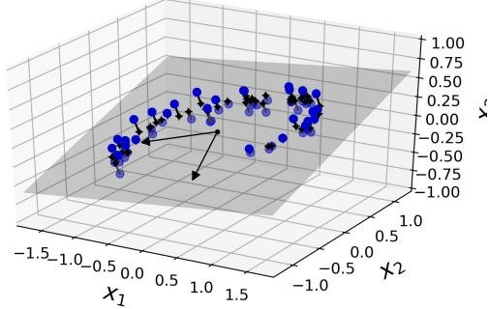
Dimensionality Reduction - Projection
Projection :
When all training instances actually lie within (or close to) a much lower dimensional subspace of the high-dimensional space
Notice that all training instances lie close to a plane
Notes:
For example
The data is first run through a kernel function and temporarily projects them into a new higher-dimensional feature space where the classes become linearly separable (classes can be divided by drawing a straight line). Then the algorithm uses the normal PCA to project the data back onto a lower-dimensional space.

Slide 10
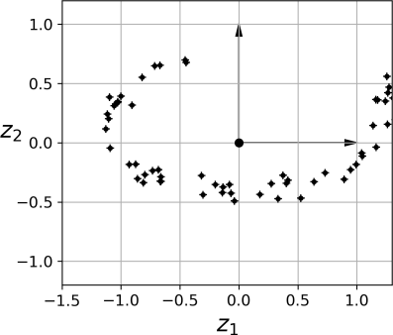
Dimensionality Reduction - Projection
We can reduce number of features from 3D to 2D by Projecting each instance perpendicularly

Slide 11
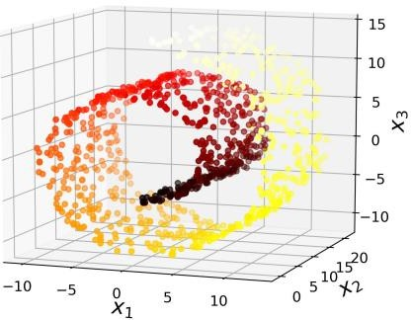
Exercise !!
In this figure , can we reduce dimensions using projection(by dropping x3) ?

Slide 12
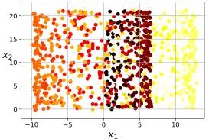
Exercise (cont.)
If you use projection (By dropping x3) it will mix different layers together

Slide 13
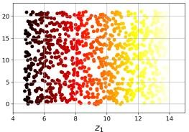
Exercise (cont.)
Instead what you really should do is this (unfold the swiss roll )

Slide 14
Dimensionality Reduction - Manifold
Manifold :
a 2D manifold is a 2D shape that can be bent and twisted in a higher-dimensional space
a d-dimensional manifold is a part of an n-dimensional space (where d < n) that locally resembles a d-dimensional hyperplane.

Slide 15
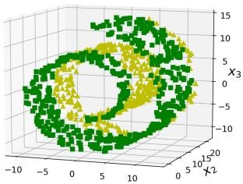
Dimensionality Reduction - Manifold
Manifold Learning:
Many dimensionality reduction algorithms work by modelling the manifold on which the training instances lie, It relies on the manifold assumption, also called the manifold hypothesis
Notes:
the manifold hypothesis is the hypothesis that many high-dimensional data sets that occur in the real world actually lie along low-dimensional latent manifolds inside that high-dimensional space.
As a consequence of the manifold hypothesis, many data sets that appear to initially require many variables to describe, can actually be described by a comparatively small number of variables, likened to the local coordinate system of the underlying manifold.

Slide 16
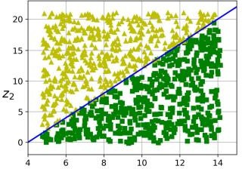
Dimensionality Reduction - Manifold

Slide 17
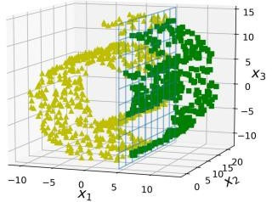
Exercise 2
If we want to reduce number of dimensions , what would you choose ? And why?

Slide 18
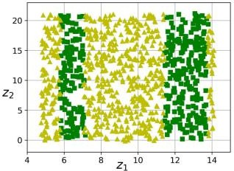
Exercise 2 (cont.)
Using manifold

Slide 19
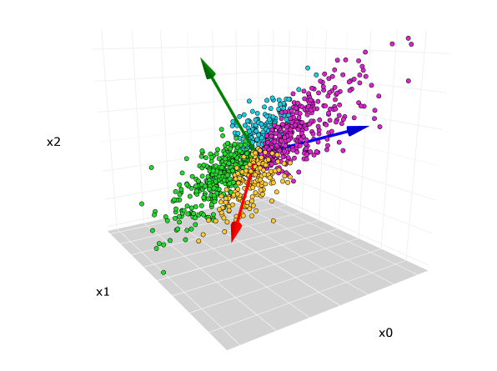
Dimensionality Reduction - PCA
Principal Component Analysis (PCA):-
is by far the most popular
dimensionality reduction algorithm.
First it identifies the hyperplane that lies closest to the data, and then it projects the data onto it.

Slide 20
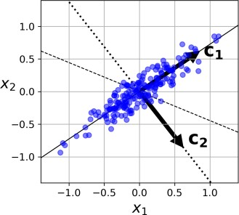
PCA- Preserve variance
How to know which plane you Should use to project at ?

Slide 21
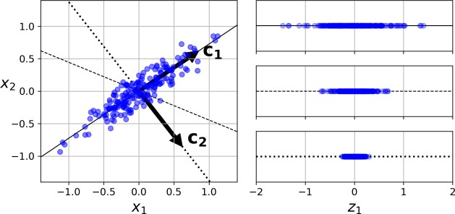
PCA- Preserve variance
How to know which plane you Should use to project at ?

Slide 22
PCA- Preserve variance
PCA identifies the axis that accounts for the largest amount of variance in the training set.it is the solid line. It also finds a second axis, orthogonal to the first one
If it were a higher-dimensional data‐ set, PCA would also find a third axis, orthogonal to both previous axes, and a fourth, a fifth, and so on

Slide 23
PCA
The unit vector that defines the ith axis is called the ith principal component (PC). the 1st PC is c1 and the 2nd PC is c2

Slide 24

PCA
explained variance ratio : It indicates the proportion of the dataset’s variance that lies along the axis of each principal component , it is available via the explained_variance_ratio_ variable

Slide 25

PCA
it is generally preferable to choose the number of dimensions that add up to a sufficiently large portion of the variance (95%)

Slide 26
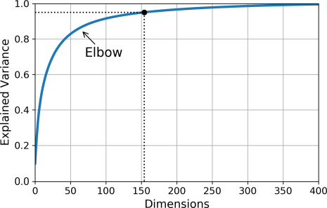
Exercise !
What does this image represents ?

